Slide 1

Static Analysis
University of Science, VNU-HCM
Faculty of Information Technology
Assoc. Prof. TRAN Minh Triet
Department of Software Engineering
Software Analysis and Design

Slide 2
Reference
“Mastering Object-Oriented Analysis and Design with UML 2.0”
IBM Software Group

Slide 3
Revision: Object Oriented Programming
Notations
Class name
Class name
Attributes
Methods

Slide 4
Visibility: Public/Protected/Private
+ public attributes/methods
# protected attributes/methods
- Private attributes/methods
Class
- privateAttribute
# protectedAttribute
Private
+publicOp()
# protectedOp()
- privateOp()
Protected
Public

Slide 5
Scope
Number of instances
Class
- classifierScopeAttribute
- instanceScopeAttribute
classifierScopeOperation()
instanceScopeOperation()
Notes:
In Rose, you cannot underline the class scope operation and attribute names, but you can use an attribute and operation stereotype (e.g., <<class>>) to denote class scope attributes and operations on a diagram.

Slide 6
Example
Student
- name
- address
- studentID
- nextAvailID : int
+ addSchedule(theSchedule : Schedule, forSemester : Semester)
+ getSchedule(forSemester : Semester) : Schedule
+ hasPrerequisites(forCourseOffering : CourseOffering) : boolean
# passed(theCourseOffering : CourseOffering) : boolean
+ getNextAvailID() : int

Slide 7
Hints
Regular: regular class
Italic: abstract class/Interface
Underlined: object (not a class)
Class name
Attributes
Regular: regular attribute
Italic: not applicable
Underlinedi: static attribute
Methods
Regular: regular method
Italic: virtual/override method
Underlinedi: static method

Slide 8
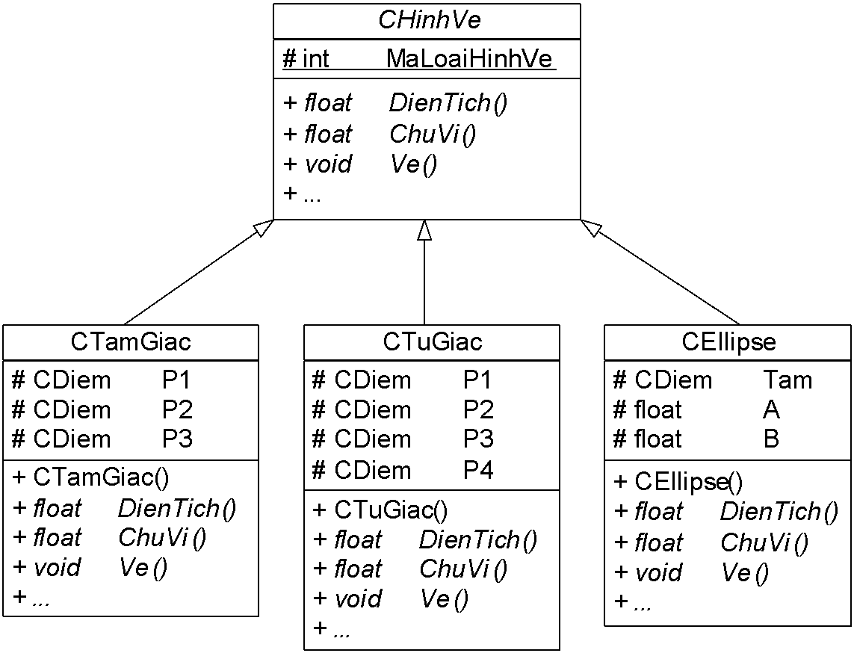
Example

Slide 9
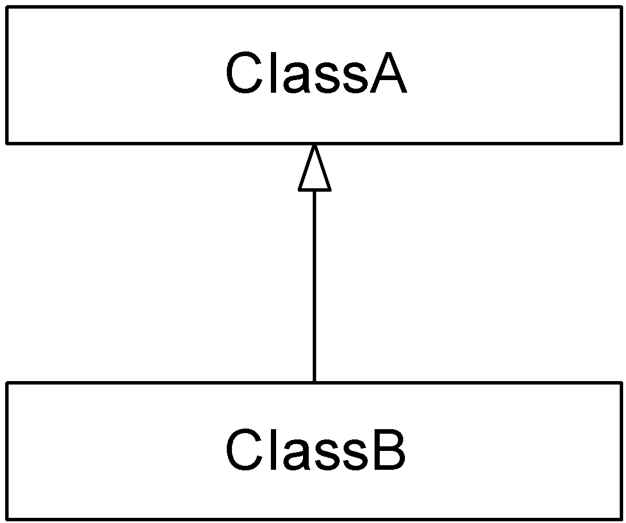
Relationships between classes
Generalization
ClassB inherits ClassA
ClassB is a special case of ClassA
ClassA is a general case of ClassB

Slide 10
Relationships between classes
Association
There is an attribute of ClassB in ClassA
or
There is an attribute of ClassA in ClassB
The attribute can be represented as a single variable, an array, a pointer, etc
Example:?

Slide 11
Relationships between classes
Aggregation
There is an association relationship between ClassA and ClassB
More details?
ClassB is a part of ClassA
ObjectX of ClassA is destroyed then ObjectY of ClassB (belongs to ObjectX) may have a chance to “survive”
Example:?

Slide 12
Relationships between classes
Composition
There is an association relationship between ClassA and ClassB
More details?
ClassB is a part of ClassA
ObjectX of ClassA is destroyed then ObjectY of ClassB (belongs to ObjectX) must be destroyed
Example:?

Slide 13
Relationships between classes
Direction of a relationship (Association, Aggregation, Composition)
Uni-directional relationship : most of the function calls between objects of ClassA and Class B follow the direction of the relationship
Undirectional relationship: there is no arrow head of the relationship

Slide 14

Relationships between classes
Multiplicity (Association, Aggregation, Composition)
Semantic?
Example:
1
2
1..*
0..*
*
1, 3, 5..9

Slide 15
Relationships between classes
Dependency
There is no association relationship between ClassA and ClassB
ClassA “depends” on ClassB
Input parameter
Returned value
Local variable
class A
{
void F(B x)
{
…
}
};
class A
{
B F()
{
…
}
};
class A
{
void F()
{
B x;
}
};
Global variable
Static function
Static attribute

Slide 16
(Analysis) Class Diagram

Slide 17
List of class candidates
How can we recognize a class (and its name)
Identifier
Life cycle:
Relative independence
…
Hints:
People
Thing
Organization
Place
Time
Concept…
A class name is usually a noun or a noun phrase

Slide 18
List of class candidates
List of class candidates
Proposed class
Not a valid class
A valid class
Irrelevant
Relevant
A subordinate class
A main class

Slide 19
Example
Context: A high school
Class or not a class?
List of class candidates:
Student Department Number of periods
Teacher Board of Schedule
Course Class Academic transcript
Student’s parent Room Semester
GPA Academic Year Type of student …

Slide 20
Example
Relavent/irrelavent?
Student Management System:
Student, Teacher, Course, Class, Student’s Parent, Semester, Academic Year…
Teacher Management System :
Teacher, Department, Course, Class, Semester, Academic Year …
Timetabling System :
Teacher, Course, Class, Room, Semester, Academic Year…

Slide 21
Example
Main class/subordinate class
Student Management System:
Student, Teacher, Course, Class, Student’s Parent, Semester, Academic Year…
Teacher Management System :
Teacher, Department, Course, Class, Semester, Academic Year …
Timetabling System :
Teacher, Course, Class, Room, Semester, Academic Year…

Slide 22
List of possible relationships
Criteria
Verb
Dependency between objects of the same class or different classes
Hints:
Current/temporary relationship
Relationship within the whole life cycle

Slide 23
How to develop a class diagram?
Step 1: Identify classes, relationships, attributes and methods (responsibility) directly from software requirement
Step 2:
If a class contains an attribute with a complex structure or there are several attributes with strong relationships and a clear semantic, create a new subordinate class

Slide 24
How to develop a class diagram?
Step 3:
3.1. Multiple classes with similarities (common
🡺 Create a new abstraction (a new class) as the generalization of such classes.
3.2. A class with an classification attribute and the behaviors of instances in that class depend on the value of that attribute
🡺 Split the class into several sub-classes, each of which corresponds to a subgroup of instances having the same value of the classification attribute

Slide 25
How to develop a class diagram?
Step 4:
Modify relationships between classes
Step 5:
Refine the class diagram (personal experience required)

